Slide 1

Perspective Development based on Internet of Things and Micro Devices
Presented By,
Muneer Khan
The Fu Foundation School of Engineering and Applied Sciences, Manhattan, New York, USA
Venue,
Graphic Era Hill University, India
Muneer Khan, Graduate Scholar at Columbia University NYC Date: July 19, 2021

Slide 2

Muneer Khan, Graduate Scholar at Columbia University NYC Date: July 19, 2021

Slide 3
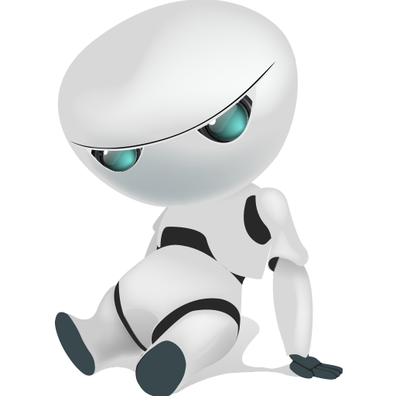
AZENDA
1. Introduction
2. Internet of Things
3. Internet of Things (IoT) Wave
4. IoT Architecture & Building Blocks
5.Description
6. Applications
7. Career Planning
7. Conclusion
Muneer Khan, Graduate Scholar at Columbia University NYC Date: July 19, 2021

Slide 4
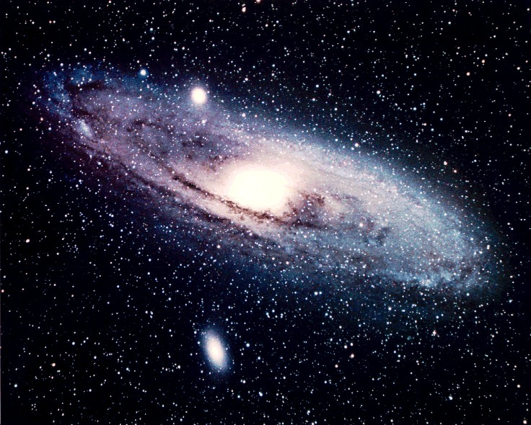
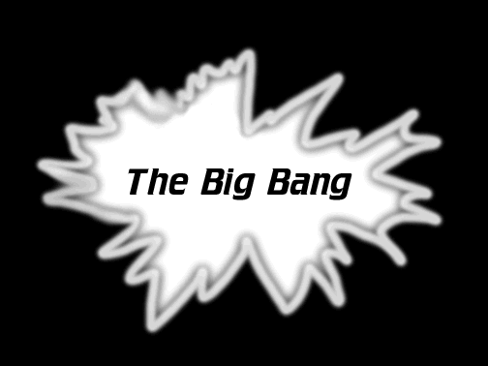
Origin of the Universe, Approx. 13.8 billion years
Big Bang Bit Bang
Muneer Khan, Graduate Scholar at Columbia University NYC Date: July 19, 2021

Slide 5
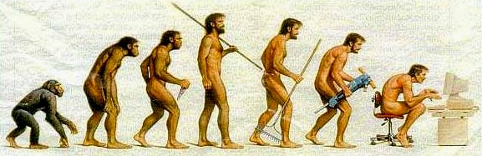
Evolution – The e-Journey
Processes from Manual to mechanical to Cyber , automated , smart, AI- machine learning- IOT and the list goes on…………..
Muneer Khan, Graduate Scholar at Columbia University NYC Date: July 19, 2021

Slide 6
Fire
Water
Wild Animals
Wind
Earth
He looked around
Muneer Khan, Graduate Scholar at Columbia University NYC Date: July 19, 2021

Slide 7
“Digital is the main reason, just over half of the companies on Fortune 500 have disappeared since the year 2000”.
Pierre Nanterms (CEO, Accenture)
Muneer Khan, Graduate Scholar at Columbia University NYC Date: July 19, 2021

Slide 8
Diseases
Hurricane
Animal Conflicts
He Struggled
Tsunami
Volcano
Muneer Khan, Graduate Scholar at Columbia University NYC Date: July 19, 2021

Slide 9
“The Internet of Things (IoT) is a system of interrelated computing devices, mechanical and digital machines, objects, animals or people that are provided with unique identifiers and the ability to transfer data over a network without requiring human-to-human or human-to-computer interaction.”
Muneer Khan, Graduate Scholar at Columbia University NYC Date: July 19, 2021

Slide 10
Internet of Things
The goal behind the Internet of things is to have devices that self report in real-time, improving efficiency and bringing important information to the surface more quickly than a system depending on human intervention
Muneer Khan, Graduate Scholar at Columbia University NYC Date: July 19, 2021

Slide 11
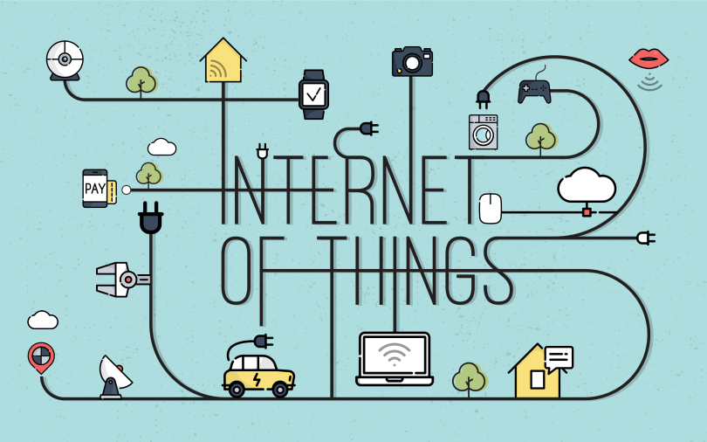
Muneer Khan, Graduate Scholar at Columbia University NYC Date: July 19, 2021

Slide 12
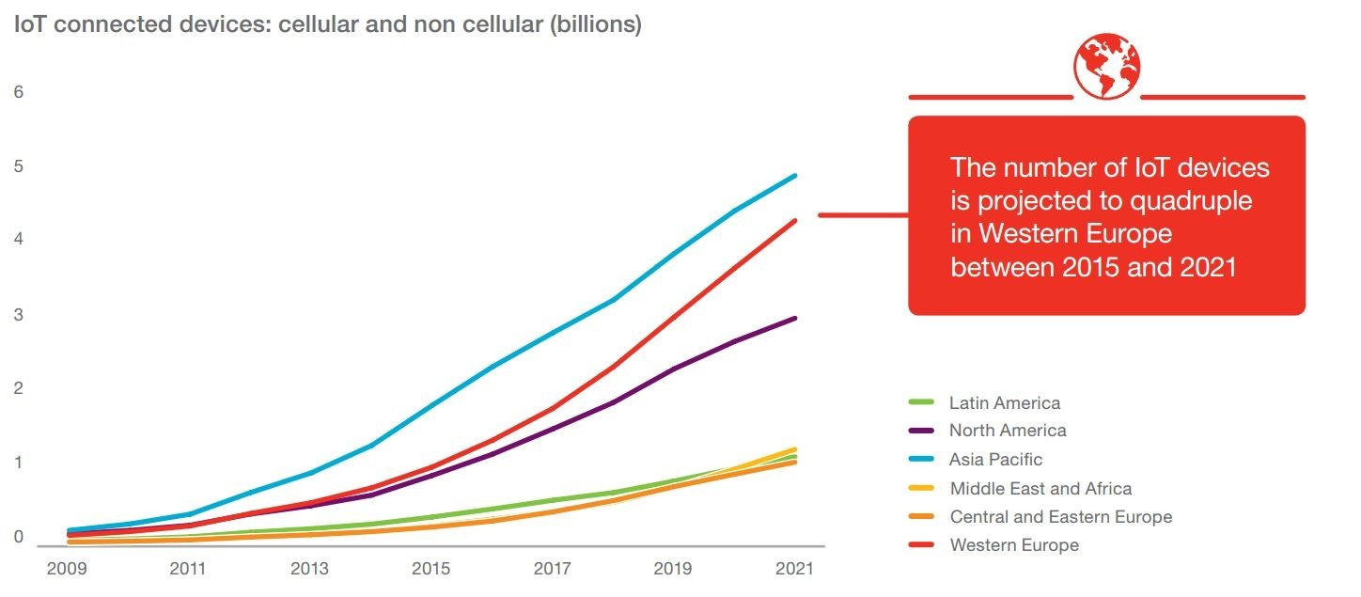
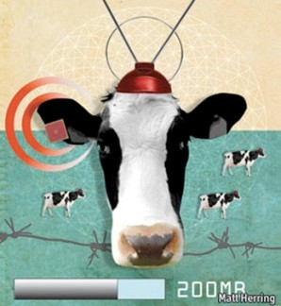
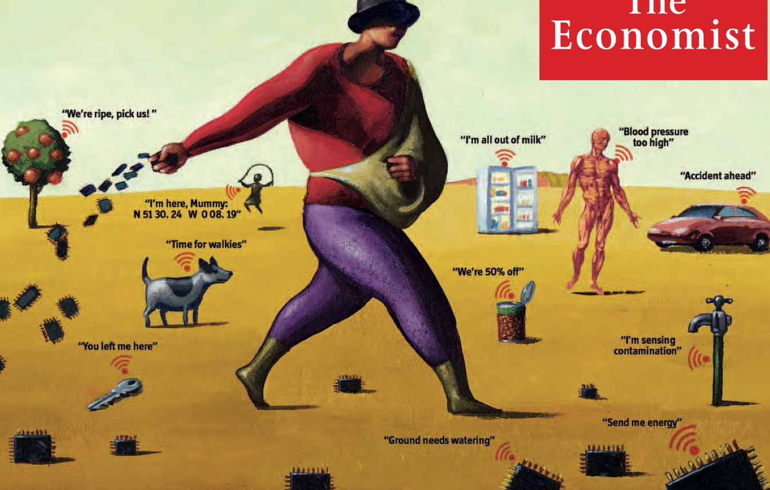
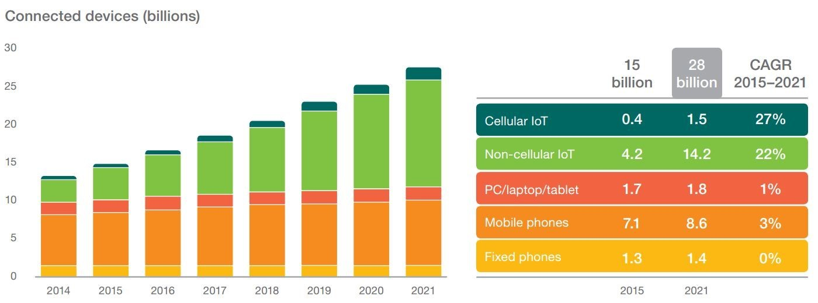
Internet of Things (IoT) Wave
Internet of Things (IoT): Enabling communication between devices, people & processes to exchange useful information & knowledge that create value for humans
Term first proposed by Kevin Ashton in 1999
Muneer Khan, Graduate Scholar at Columbia University NYC Date: July 19, 2021

Slide 13


Architecture Drivers
Large Scale
Millions of clients in a single network. IPv6 is the right way to go…
Security
Sensors exposed to the world, data travels through public networks …
Constrained Devices
Lossy networks, low bandwidth, small batteries …
Large Volume
Millions of sensors produce tons of data, all the time …
Legacy Support
Non-IP, specialized devices, multiple vertical solutions
Need for Real-Time
What happens now may result in proactive action …
Muneer Khan, Graduate Scholar at Columbia University NYC Date: July 19, 2021

Slide 14
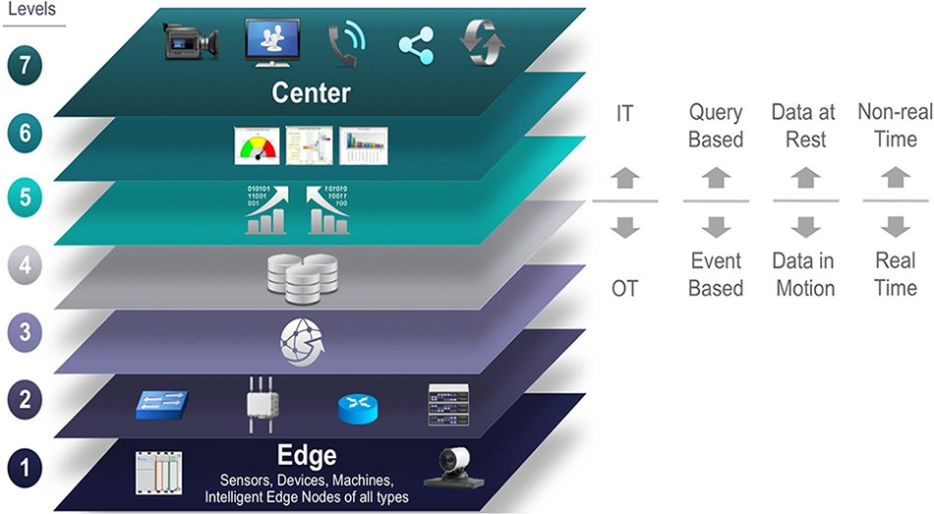
IoT World Forum Reference Model
Muneer Khan, Graduate Scholar at Columbia University NYC Date: July 19, 2021

Slide 15
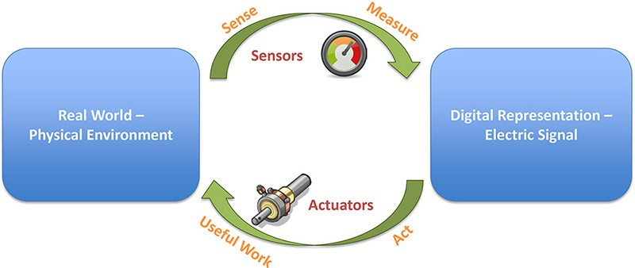
Sensor vs. Actuators
1) Physical Devices & Controllers
Muneer Khan, Graduate Scholar at Columbia University NYC Date: July 19, 2021

Slide 16
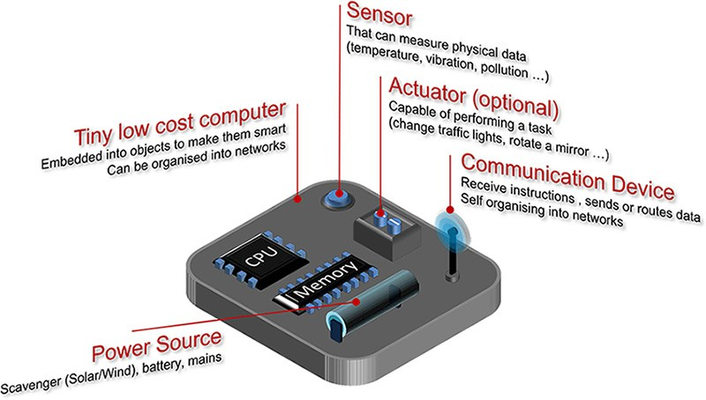
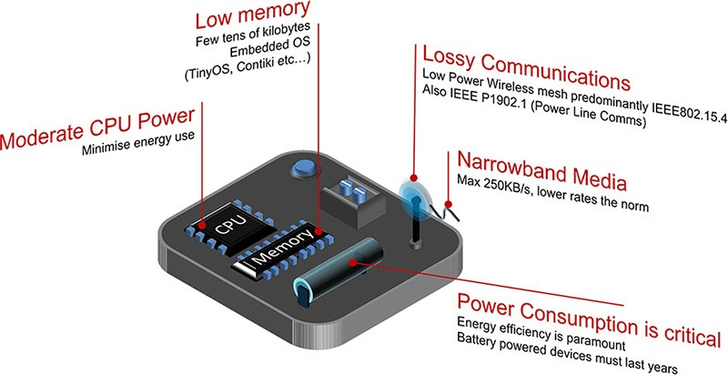
1) Physical Devices & Controllers
Smart Objects
Muneer Khan, Graduate Scholar at Columbia University NYC Date: July 19, 2021

Slide 17
Sensor Characteristics
1) Physical Devices & Controllers
2) Connectivity
Connected to Power or Battery operated
Lower power need to transmit less often, at shorter range, simpler data
Mobile or Static
What is the range and frequency of mobility?
Impact on power and Gateway
Low or High Reporting Frequency
Hundred of times per second, or once or twice a month?
Simple or Rich Data
One status bytes or hundreds of parameters?
Transmission Range
Few feet or several miles?
Density per Cell
“a few sensors” or “several thousands”?
Muneer Khan, Graduate Scholar at Columbia University NYC Date: July 19, 2021

Slide 18
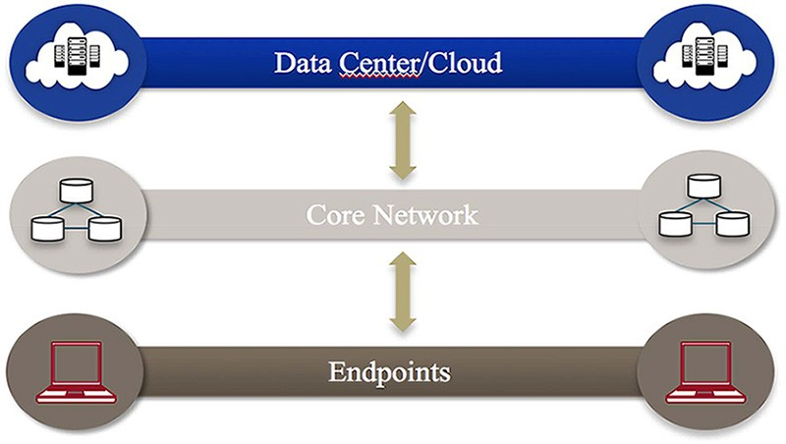
Traditional IT Cloud Computing Model
3) Edge Computing
Standard model
Endpoint like computer, notebooks, tablets … connect to a core network
communication between endpoints
data center or cloud backend where an application is running
3 layered connectivity architecture
Muneer Khan, Graduate Scholar at Columbia University NYC Date: July 19, 2021

Slide 19
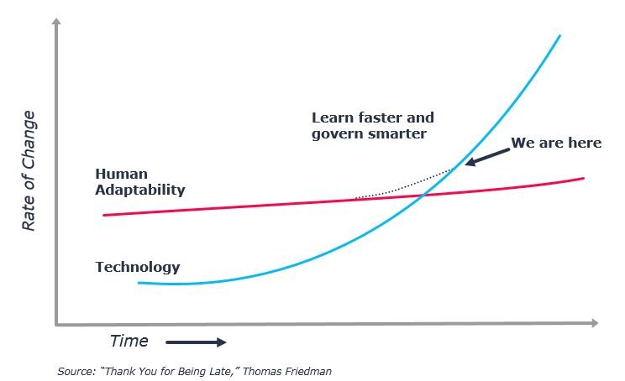
Muneer Khan, Graduate Scholar at Columbia University NYC Date: July 19, 2021

Slide 20




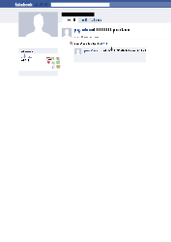
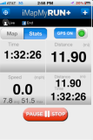
People Connecting to Things
ECG sensor
Internet
Motion sensor
Motion sensor
Motion sensor
Muneer Khan, Graduate Scholar at Columbia University NYC Date: July 19, 2021

Slide 21
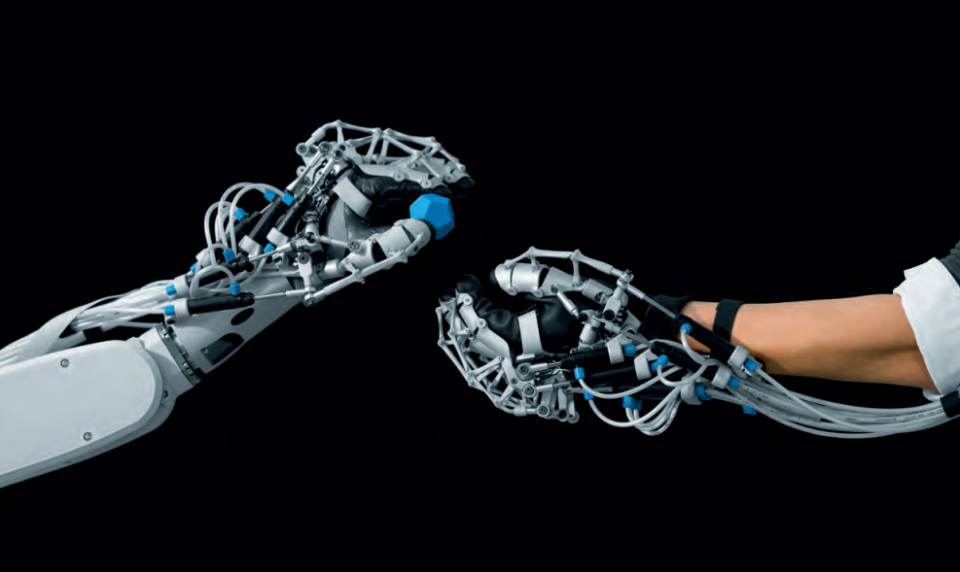
Safety Intelligent Sensors for Collaborative Robotics
Muneer Khan, Graduate Scholar at Columbia University NYC Date: July 19, 2021

Slide 22
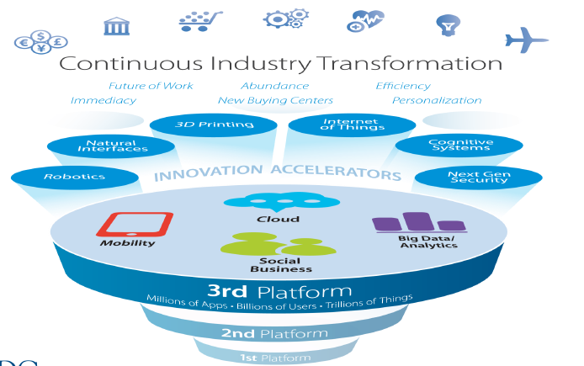
Convergence in EVERYWHERE
Convergence of technology
Convergence of business and ecosystem
Convergence of people, application, things, data, devices, etc.
Source: IDC
Muneer Khan, Graduate Scholar at Columbia University NYC Date: July 19, 2021

Slide 23


AUTOMATED IoT BASED SMART
WATER QUALITY ASSESSMENT SYSTEM
Muneer Khan, Graduate Scholar at Columbia University NYC Date: July 19, 2021

Slide 24
BLOCK DIAGRAM OF WATER MONITORING SYSTEM
LCD
Temperature Sensor
Microcontroller
Arduino
GSM Module
Water Body
PH Sensor
Turbidity
Monitoring Center
TDS
Muneer Khan, Graduate Scholar at Columbia University NYC Date: July 19, 2021

Slide 25
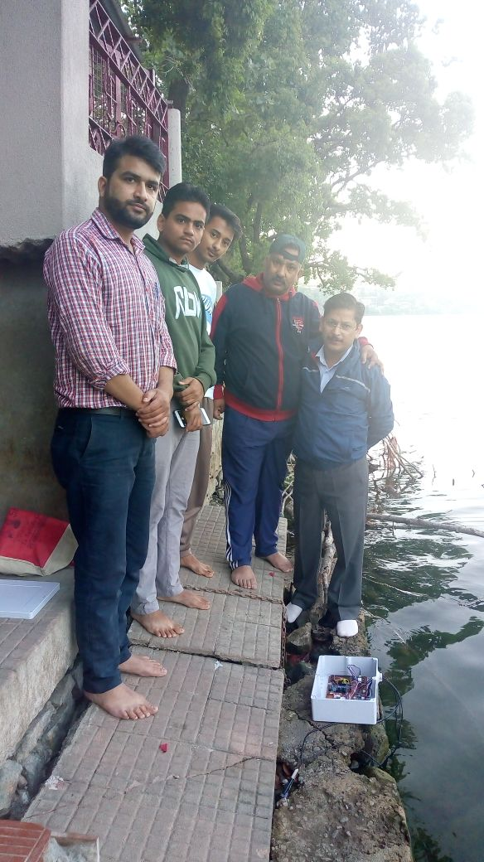
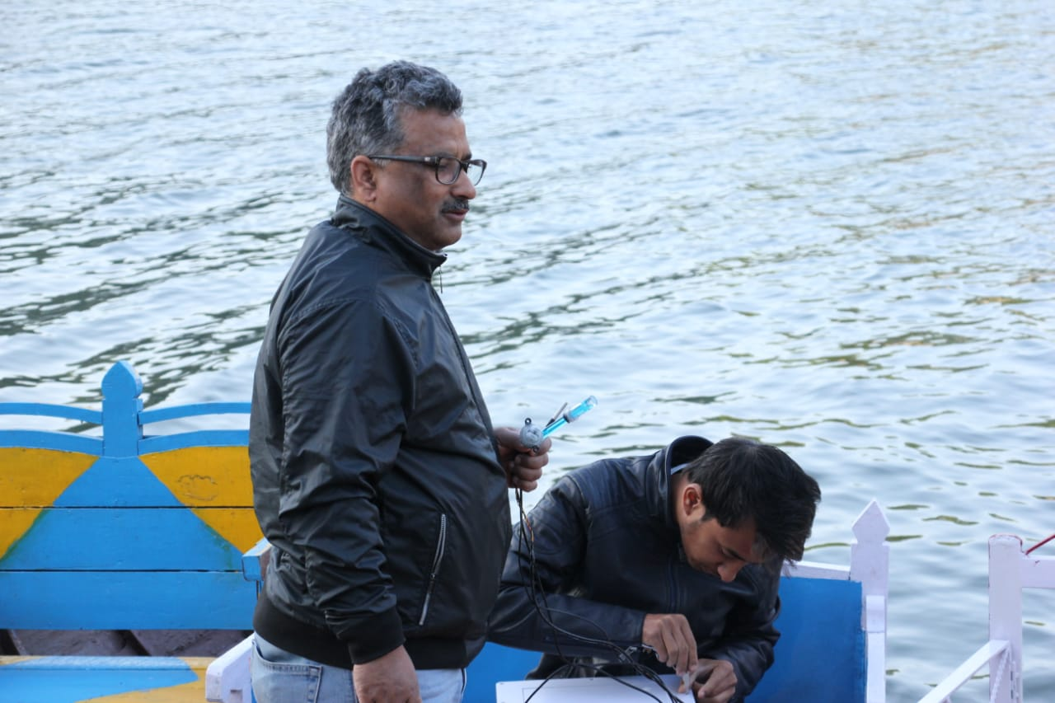
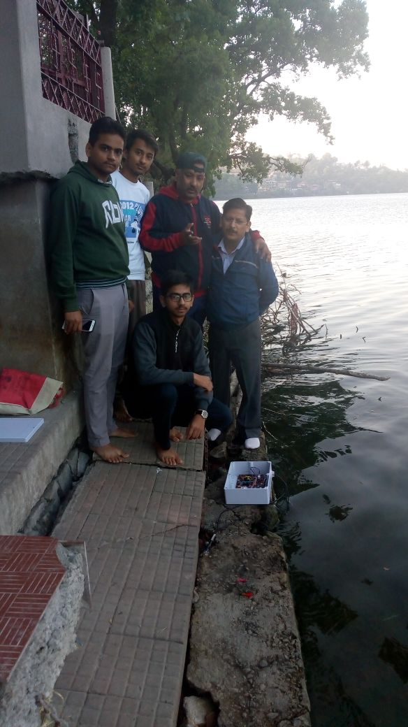
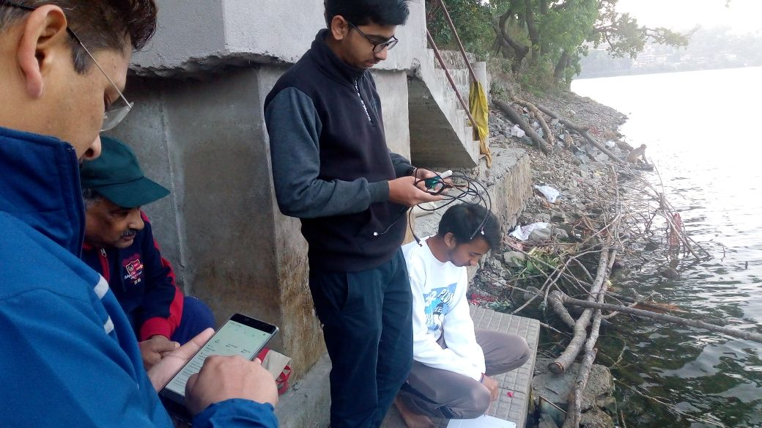
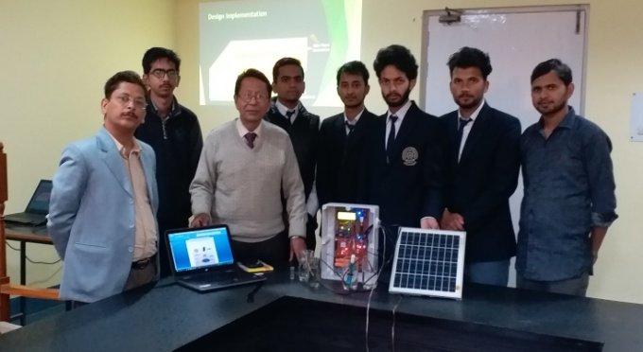
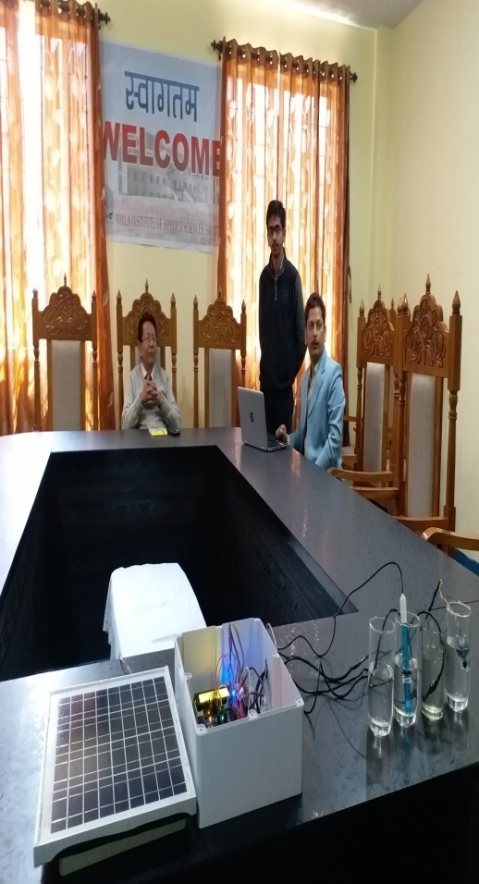
Device Testing at Bhimtal Lake
Muneer Khan, Graduate Scholar at Columbia University NYC Date: July 19, 2021

Slide 26
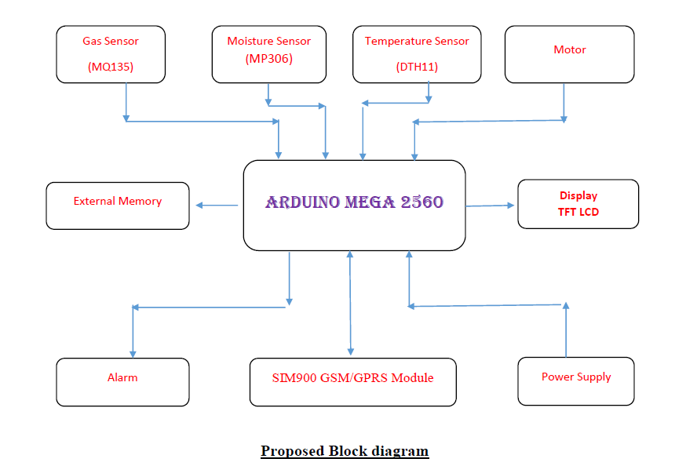
SOIL testing : How farmers can benefit out of technologies
WI-FI BASED AGRICULTURE MONITORING SYSTEM USING GAS, SOIL, TEMPERATURE & HUMIDITY SENSOR
Muneer Khan, Graduate Scholar at Columbia University NYC Date: July 19, 2021

Slide 27
Technological trends
Desktop Computers
Handheld Devices
Smart Systems
Artificial Intelligence
Machine Learning
Virtual Reality
Augmented Reality
IOT
Muneer Khan, Graduate Scholar at Columbia University NYC Date: July 19, 2021

Slide 28
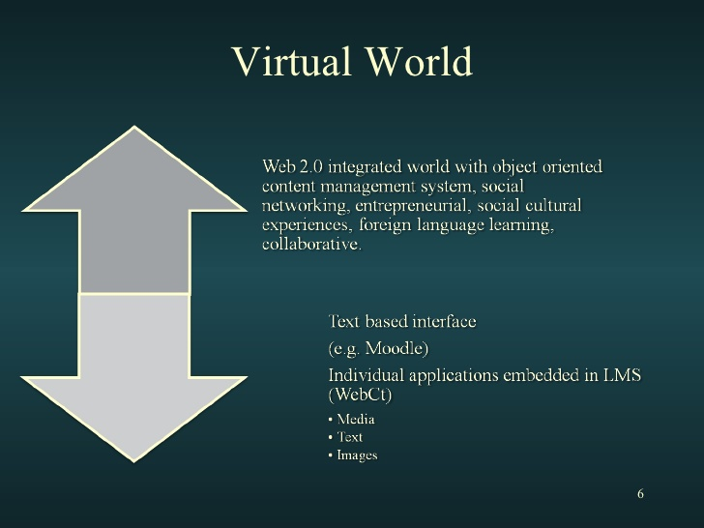
Muneer Khan, Graduate Scholar at Columbia University NYC Date: July 19, 2021

Slide 29
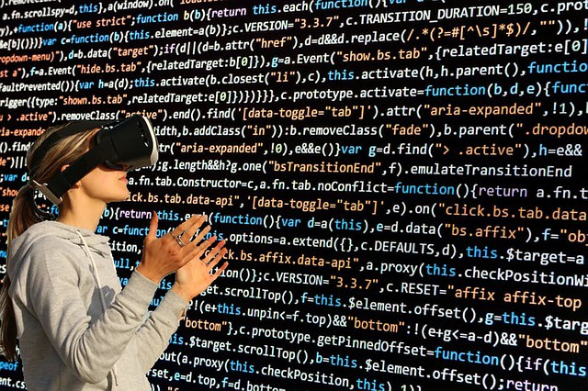
Soon VR will become an experience akin to that which we all had when the TV was wheeled into our classes all those years ago!
Muneer Khan, Graduate Scholar at Columbia University NYC Date: July 19, 2021

Slide 30

Start by doing what is necessary, then what is possible, and suddenly you are doing the impossible.
Muneer Khan, Graduate Scholar at Columbia University NYC Date: July 19, 2021

Slide 31

Objective:-
To spread awareness about different INTERNSHIP opportunities available for all students of B.Tech. 2nd and 3rd year which will direct them to explore and will motivate them to select the best one available in their particular area of interest.
Muneer Khan, Graduate Scholar at Columbia University NYC Date: July 19, 2021

Slide 32
Introduction :- So first of all, what is Internship ?
An internship is an opportunity to enhance classroom learning through practical career-related work experience.
Apart from providing experience and stipends, it helps students in determining whether they are actually interested in a particular career or not.
Students get chance to make lasting contacts with professionals in a related field of interests. A good internship can potentially become a defining moment towards your career.
Muneer Khan, Graduate Scholar at Columbia University NYC Date: July 19, 2021

Slide 33









So what are the different types of internships available for students?
Foreign
Internships
Industrial
Types of
internships
Internships
IIT/IIIT Interns
Other
Internships
Muneer Khan, Graduate Scholar at Columbia University NYC Date: July 19, 2021

Slide 34
Industrial Interns !!
Training and Placement Representatives (TPRs) of respective departments contacting various industries and companies in India and sending the student database to them and companies inviting them as per requirement.
Companies’ campus recruitment for internship through Personal Interviews (PI). This mode is very beneficial for getting a PPO (Pre Placement Offer) from the same company to join them later after B.Tech.
Students having contacts of officials concerned to some project work can directly approach them to get an offer for industrial training.
Muneer Khan, Graduate Scholar at Columbia University NYC Date: July 19, 2021

Slide 35
Industrial Interns !!
Training and Placement Representatives (TPRs) of respective departments contacting various industries and companies in India and sending the student database to them and companies inviting them as per requirement.
Companies’ campus recruitment for internship through Personal Interviews (PI). This mode is very beneficial for getting a PPO (Pre Placement Offer) from the same company to join them later after B.Tech.
Students having contacts of officials concerned to some project work can directly approach them to get an offer for industrial training.
Muneer Khan, Graduate Scholar at Columbia University NYC Date: July 19, 2021

Slide 36
IIT Bombay !! Register for Summer Internships (Specially for CSE)
IIT Bombay is actively involved in central government’s ambitious National Virtual Library and Educational Services for Outreach at Scale (ESOS) projects.
In May-June 2018, around 73 interns worked on summer internship projects. Our internship projects develop useful software for our initiatives while simultaneously enabling the participants to fulfil summer internship requirements of their respective academic programs.
Eligibility;
Apply for internship only if you are completing 3rd year in April/May of each year. Students completing 2nd year, with exceptional academic performance and other achievements may also be considered.
http://www.iitb.ac.in/en/education/research-internship , http://www.iitb.ac.in/newacadhome/toTraining.jsp , https://www.it.iitb.ac.in/summerinternship2019/register.html
Muneer Khan, Graduate Scholar at Columbia University NYC Date: July 19, 2021

Slide 37
SURGE Programme: IIT Kanpur (http://surge.iitk.ac.in/ )
SPARK Programme, IIT Roorkee (http://spark.iitr.ac.in/ )
IIT Bhuwaneshwar summer Internship (http://webapps.iitbbs.ac.in/summer_internship-application/ ) **last date March 31st ,
IIIT Delhi, Summer Insternship : (https://www.iiitd.ac.in/placement/summer-internships ) **last date March 31st ,
Summer Fellowship Programme: IIT Madras, IIT Delhi, IIT Jodhpur, IIT Gandhinagar, IIT Guwahati etc.
Muneer Khan, Graduate Scholar at Columbia University NYC Date: July 19, 2021

Slide 38
Foreign Internships !!
Students can also proceed towards pursuing a summer internship at international level. There are so many programs available for this and a few out of them are listed below. It is recommended to visit their respective web sites for detailed information, eligibility, requirements and other details.
DAAD – WISE (Germany) https://www.daad.de/en/
Charpak Scholarship ( France ) http://www.inde.campusfrance.org/en/
Global Leadership Scholarship (Taiwan) http://bel.uq.edu.au/bel-taiwan-scholarships
MITACS Globalink (Canada) http://www.mitacs.ca/globalink
Viterbi-India Internship Program (USA) http://viterbi.usc.edu/students/summerinternship/viterbi-indiaprogram.htm
** It is recommended to visit their respective web sites for detailed information, eligibility, requirements and other details.
Muneer Khan, Graduate Scholar at Columbia University NYC Date: July 19, 2021

Slide 39

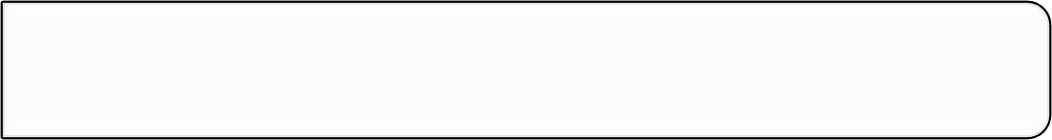


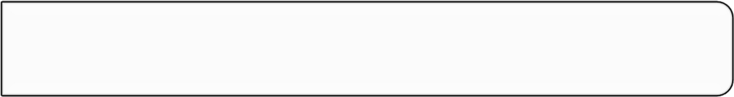



•
Search For Professors working in your field of interest.
•
Make a database of their email
Search
-
ids and contacts.
•
Prepare your cover letter and CV.
Draft
•
Keep in mind the interests of professor.
•
Send your research proposal to the professor.
Mail
•
Always send individually, and keep in mind time difference.
•
Keep trying the above by mailing to different professors, till
Wait
you get acceptance and invitation letter.
•
After Getting Acceptance ask for scholarship and funding.
Funding
Muneer Khan, Graduate Scholar at Columbia University NYC Date: July 19, 2021

Slide 40
Important points for application procedure:-
It should be noted that sending an e-mail is a very crucial step and students frequently commit a mistake in this resulting into loss of a big opportunity. So, following guidelines are proposed while sending an email.
Never send your cover letter and CV as attached files in your email. Use e-mail writing section for this.
Always mention waiting to hear from you at the end of cover letter.
Never send mails to two different professors of the same university (department) on a single day.
Never copy-paste the same Cover Letter all the time. Edit it based on the Field of interest of recipient professor.
Never send mail on weekends and check the office hours of recipient Professor.
Avoid sending mails in bulk as it may drop in to spam folder of recipient professor.
Muneer Khan, Graduate Scholar at Columbia University NYC Date: July 19, 2021

Slide 41
One Final Point!
Don’t apply for internship, just for the sake of getting one. Especially for research internships, apply only if you are really interested in the research field.
If you do get an internship/training experience – good or bad, please don’t forget that there will be many many juniors throughout the country who will be needing your help, so come, take a step back and share your experiences for everyone.
Muneer Khan, Graduate Scholar at Columbia University NYC Date: July 19, 2021

Slide 42

***
Muneer khan
mk4523@Columbia.edu
Muneer Khan, Graduate Scholar at Columbia University NYC Date: July 19, 2021

